Slide 1
Jira AI Bug Agent
Revolutionizing Issue Management with
MuleSoft AI Chain

Slide 2

The Problem: Manual Analysis Bottlenecks
Information Overload
Large projects generate hundreds of comments and complex descriptions that are time-consuming to process manually.
Subjectivity
Manual sentiment assessment is often inconsistent across different support representatives, leading to unreliable data.
Delayed Action
The time spent manually summarizing cases delays the actual resolution of critical bugs, impacting customer satisfaction.

Slide 3
Our Solution: A Unified & Intelligent Platform
Built on the MuleSoft Anypoint Platform, the Jira AI Bug Agent leverages enterprise-grade integration capabilities to deliver a reliable, automated, and intelligent issue management workflow.
AI-Powered Core
Utilizes the MuleSoft AI Chain Connector to orchestrate complex AI workflows and LLM interactions.
Automated Workflow
Triggered by Jira events to perform real-time analysis and summarization without human intervention.
Bi-Directional Sync
Automatically fetches issue data and writes back AI-generated insights directly into Jira custom fields.

Slide 4

Technical Architecture
Event-Driven Design
The system listens for Jira webhooks to initiate the AI Agent flow, ensuring real-time responsiveness.
MuleSoft AI Chain (MAC)
Acts as the orchestration layer, seamlessly connecting MuleSoft flows to advanced LLMs like GPT-4o-mini.
Modular Components
JIRA CONNECTOR | AI CHAIN CONFIG
OBJECT STORE | DATAWEAVE 2.0

Slide 5
Core AI Capabilities
Intelligent Summarization
Builds a concise case view from summaries, descriptions, and comments.
Applies a support-rep persona for accurate, single-sentence summaries.
Generates clear next steps to guide the development team.
Automated Sentiment Analysis
Instantly assesses the emotional tone of interactions.
Stores sentiment scores directly in Jira custom fields for reporting.
Converts qualitative feedback into consistent, unbiased metrics.
Helps teams prioritize issues with high customer frustration.

Slide 6
Under the Hood: How It Works
Orchestration
Scatter-Gather pattern for concurrent processing.
Global Error Handler for reliability and logging.
Transformation
DataWeave 2.0 converts Jira responses to AI-ready payloads.
Aggregates issue descriptions and comments.
Security
Secure Properties for externalized credentials.
Object Store for efficient state management.

Slide 7
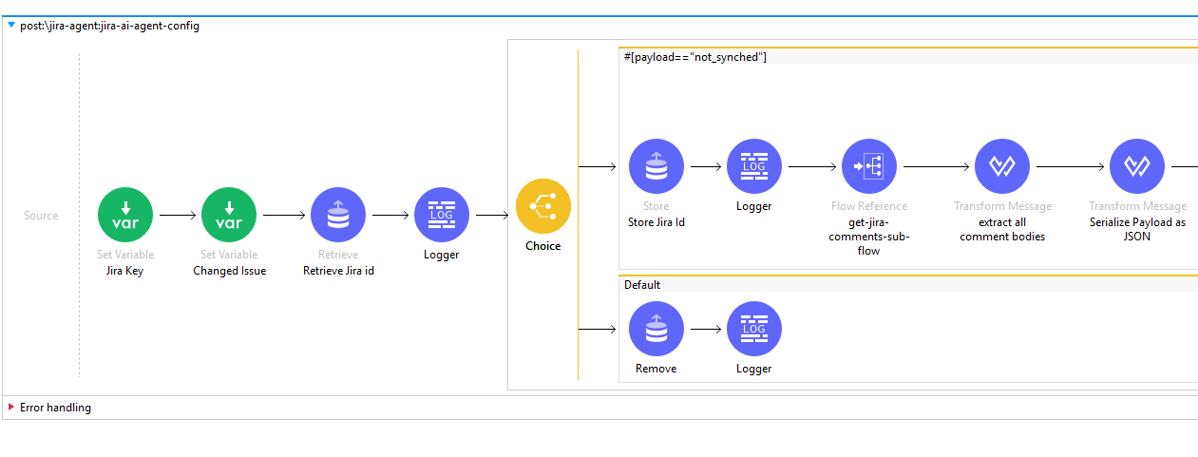
Project Flow

Slide 8
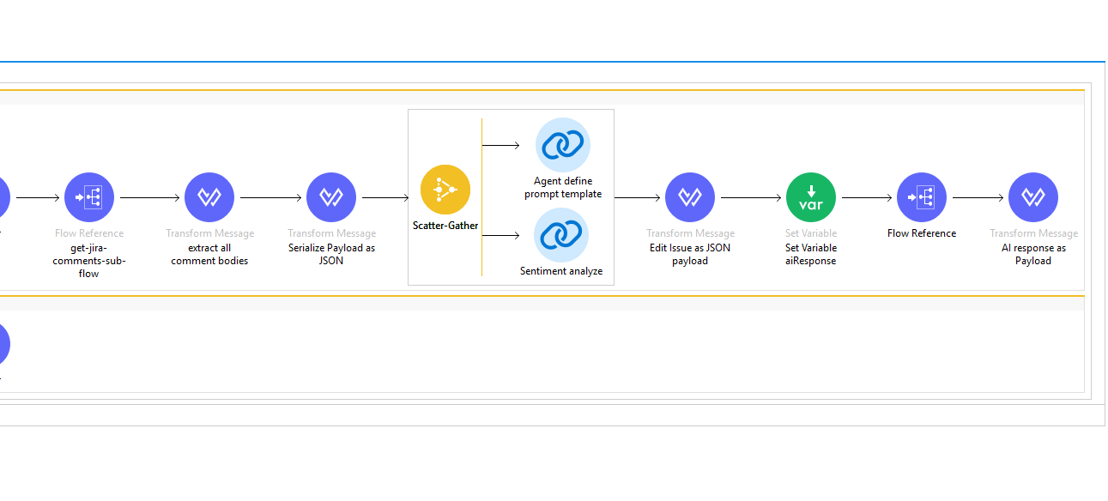
Project Flow
Flow

Slide 9
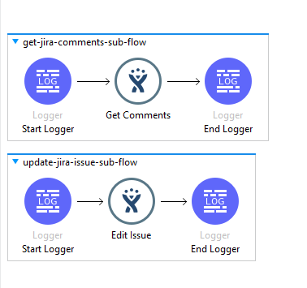
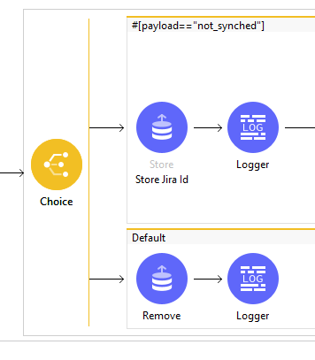
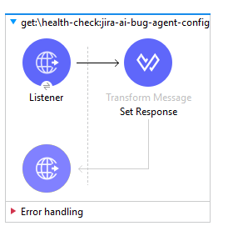
Project Flow
Subflows
Health Check
Choice Router

Slide 10
Tangible Business Impact
70% Time Savings
Significant reduction in manual effort spent on bug triaging and case summarization.
Improved Accuracy
Elimination of human error and subjectivity in sentiment tracking and issue analysis.
Faster Resolution
Immediate context for developers leads to quicker bug fixes and improved system reliability.

Slide 11
The Path Ahead
Advanced RAG
Integrating Retrieval-Augmented Generation to reference historical bug fixes and documentation.
Multi-Language Support
Expanding sentiment analysis and summarization to support global customer bases.
Automated Labeling
Using AI to suggest Jira labels and components based on issue content.
Dashboard Integration
Visualizing sentiment trends and AI performance using Anypoint Visualizer and Jira Dashboards.

Slide 12

Empowering Teams with AI
The Force Multiplier
Jira AI Bug Agent bridges the gap between raw data and actionable insights, enabling teams to focus on what matters most: building great software.
Key Takeaway
By combining MuleSoft's integration power with AI's analytical capabilities, we transform bug tracking from a manual chore into an intelligent, automated workflow.

Slide 14
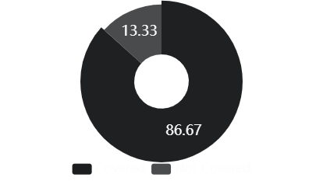
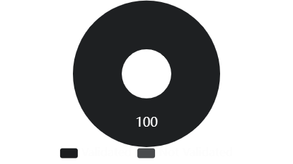
Proven Performance & Quality
Continuous integration ensures that changes to AI prompts or MuleSoft flows do not break existing functionality, maintaining enterprise-grade reliability.

